Slide 1
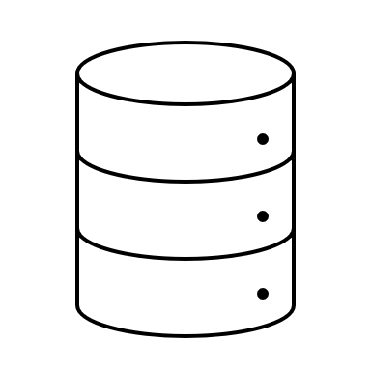






Problem Statement
Data Silos
Flexibility
Batch Processing
Driven
Data Trust
Scalability
Data Ownership

Slide 2
Solution
Stream Data
Data
ingestion
Data
preparation
Train
Model
Data
Consumption
Batch Data
Data Store
Automation
Governance
Security
Monitoring

Slide 3


















Architecture
Web Apps
APIs
K
SQL
K
Streams
Databricks ML
Kafka Consumer
Stream Data
Azure API Management
API
Databricks Spark
Synapse SQL
Azure Data Lake
FTP
Synapse Copy
Synapse Data flows
Power BI
Database

Slide 4
Thank you !

Slide 5


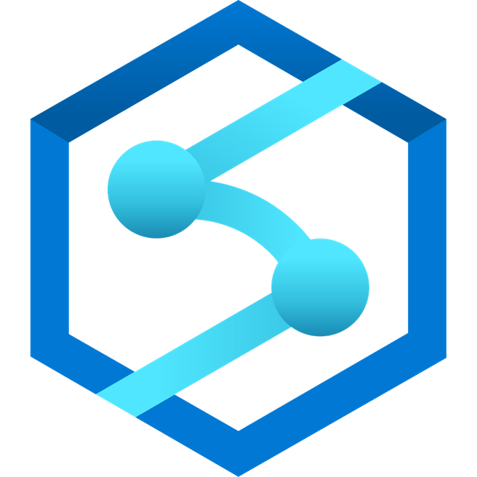

Architecture
T-SQL language
IoT ingestion without aggregation
Ingress up to 720 gigabytes/hour of raw events
Analyze data in-flight using SQL language Azure Stream Analytics
Join streaming data with other data assets in the data warehouse and data lake
Synapse SQL
Event Hubs
Streaming Ingestion
Dedicated SQL Pool
Built-in streaming ingestion & analytics
IoT Hub

